Slide 1
TU856-1 & TU858-1 Computer Architecture and Technology Module Code: CMPU 1006
Semester 1, Week 10
NETWORKS

Slide 2
Presentation Outline
This presentation is an overview of information technology networks. Looking at how networks are set up and how they allow data traffic.
It will focus on the hardware and software of networks, including network protocols.
There are some examples of cabling and wireless technologies.

Slide 3
Presentation Content - including
What is a Network? Node?
How Fast/Big is a Network?
Common LAN Topologies
Network Router
Client-Server Networks
Network Software
Protocol
Network Hardware
Copper Cables
Fibre Optic Cable
Wireless media
Internetworking
Networks Summary
Where to Next?

Slide 4
What is a Computer Network?
In computer technology a computer network is a collection of independent computers that are connected together to exchange or share data and/or software.
Put another way, ’A network is a series of points or nodes interconnected by communication paths’.

Slide 5
Node? What is a ‘node’?
Describing topology, we use the term node to refer to any independent component (device) of the network.
Those might be such things as the workstation or personal computer, server, printer…

Slide 6
How Do Networks Exchange Data?
A computer network may be ‘fixed’ – I.E. connected permanently using cables - or their links might be temporary - as when connected via modems. Wireless networks (temporary) generally work using waves in the air and are passed and then processed over ‘WiFi’ (Wireless Fidelity – a wireless local area network) or a proprietary carrier's networks – carriers being Eir (Eircom.net) and BT Ireland (BT Communications Ireland Limited).
(These variations will be expanded on later.)

Slide 7
How Fast Can Networks Exchange Data?
Network transmission speeds, measured in bits per second, range from only a few thousand bits per second (Kbps) for old networks, to millions of bits per second (Mbps).
High-speed networks often operate at around 300-500 Mbps (in an office of 2 - 20 computers) and ‘special’ applications of technology offer billions of bits per second (Gbps) (in a laboratory environment, perhaps). (I checked in the TU Dublin office: - 50 Mbps with Ethernet.)

Slide 8
Size (How Big an Area Does a Network Cover?)
A local area network (LAN), using cable, covers a geographically limited area, generally contained within a single building, or a few physically-close buildings (with a building-to-building gap of about 25 metres) – but they may go to a square kilometre at a stretch.
Networks spread over a larger area – wide area networks (WAN) – often span regions such as a province, state, a whole country or among countries.

Slide 9
Size (2)
Imagine these servers and stand-alone computers on different floors in two office blocks that are within 25 metres, say.

Slide 10
Common LAN Topologies
Four common Local Area Network topologies exist: bus, ring, star, and tree. (Five, if you include the ‘hybrid’ topology.)
These topologies are logical architectures, but the hardware devices need not be physically organised in these configurations. Logical bus and ring topologies, for example, are commonly organised physically as a star.

Slide 11
Common LAN Topologies (Bus)
A Bus Topology

Slide 12
Common LAN Topologies (Star)
A Star Topology

Slide 13
Common LAN Topologies (Ring)
Terminal
Terminal
Computer
Printer
A Ring Topology
Computer
Terminal

Slide 14
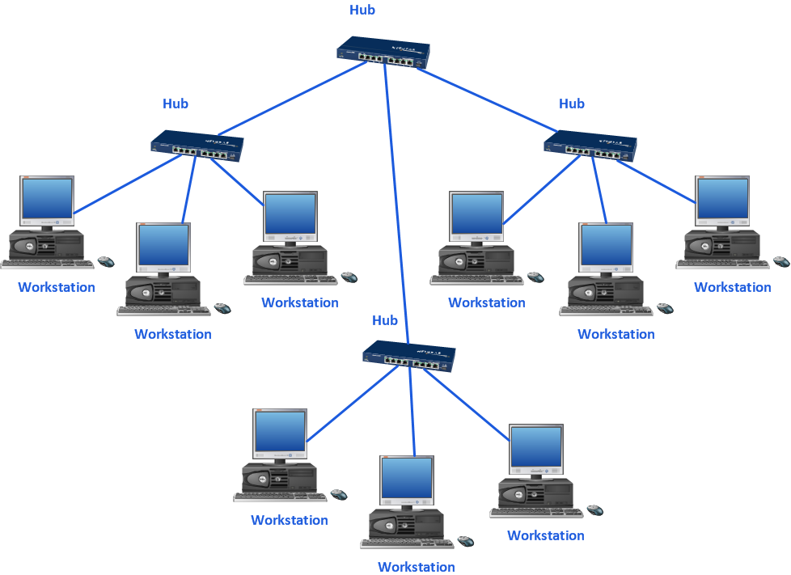
Common LAN Topologies (Tree)
A Tree Topology

Slide 15
Network Switching
To control the data traffic on a computer network the method of switching is used. There are two main switching methods for networks:
Packet switching
Circuit switching

Slide 16
Network Switching (2)
Packet-switched - a type of network in which relatively small units of data called packets are routed on a network with a destination address contained within each packet.
Circuit-switched - a type of network where a physical path is obtained for and dedicated to a single connection between two end-points in the network for the duration of the connection. Example: a telephone network.

Slide 17
The Network Router
In packet-switched networks a router is a device (and/or software) in a computer that determines the next network point to which a packet should be forwarded to take it closer to its destination. The router is connected to at least two networks and decides which way to send each information packet based on the state of the networks it is connected to. A router is located at a gateway - the hardware point where one network meets another.

Slide 18
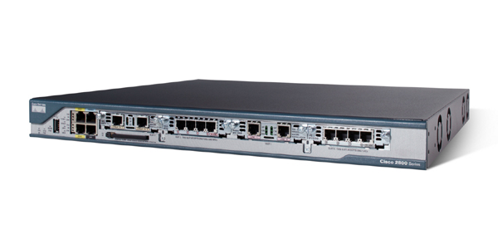
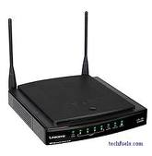
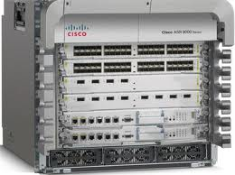
The Network Router (2)
Wireless router hardware
Cisco routers (as might be used in an office or lab)

Slide 19
The Network Router (3)
A router is often included as part of a network switch.
Router software may create or maintain a table of available routes and their conditions. The program will use this information along with distance and cost algorithms to determine the best route for a given packet.
Routing is a function called ‘Layer 3’ - it is part of a standard for engineering networks - a model called Open Systems Interconnect(ion) (OSI).

Slide 20
Client Server Networks
Client Server, client-server, client/server…
Client-Server describes the relationship between two computer programs where one program, the client, makes a service request from another program, the server, which fulfills the request.
Although the client-server idea can be used by programs within a single computer, it is more often associated with networks.

Slide 21
Client Server Networks (2)
Client Server networks:
A client/server system includes one or more servers to store programs and/or data in a central location.
Users (clients) access the programs or data when their software request to the server, across the network, is dealt with.
The client-server model provides a convenient way to interconnect programs and data that are distributed efficiently across different locations.

Slide 22
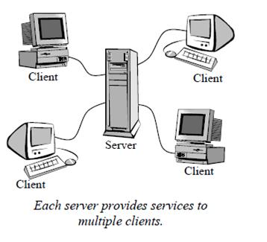
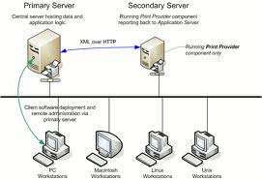
Client Server Networks (3)
Star Type
Bus Type

Slide 23
Client Server Network Example
The best known recent client/server application is the World Wide Web – the Internet.
Users send requests for a specific web page and the page is transmitted from the server to the client for display on the client's screen.

Slide 24
Client Server Network Example (2)
This puts the web page database activities on the server where the web pages are stored but puts the graphics processing needed to display the page on the local machine where the request originated.
The request/reply protocol for these exchanges is called Hypertext Transfer Protocol and is commonly known as HTTP.

Slide 25
Software for Networks – Communication Software
Computers that are connected need communication software to interact. This software will control the flow of data from node to node.
The signals, messages and files that move from one node (computer, server…) and another need to be managed. That includes checking the format of the signal, message or file.

Slide 26
Network Operating System
The software used to control many of these elements is in the form of a ‘network operating system’.
There are many forms for a network operating system (NOS).
An example of a NOS is Novell NetWare (albeit an older and soon-to-be obsolete NOS).

Slide 27
NetWare
NetWare, made by the company known as Novell, was probably the most widely-installed network server operating system.
Initially NetWare was successful in large and small office local area networks, Novell has redesigned (or refeatured) NetWare to work successfully as part of larger and heterogeneous networks, including the Internet.

Slide 28
NetWare (2)
Up until the mid-2000s NetWare was strongly affiliated to the Unix and Linux operating systems: NetWare 6 associated with Unix work, NetWare OES (Open Enterprise Server) associated with Linux.
Novell suffered from management problems and were bought out by the ‘Attachmate’ company.
Microsoft’s Network Operating Systems became popular instead.

Slide 29
Software for Networks Currently
Open source (Linux, mostly) network software has become popular, so there is no longer a universally-established software.
Current network supports (some of which are versions of Linux operating system) include these names:
LogicMonitor
Paessler PRTG
Kaseya VSA
ManageEngine OpManager

Slide 30
Protocol
To communicate with each other, two machines must follow the same protocol.
A protocol is the special set of rules that end-points in a telecommunication connection, such as two PCs on a Local Area Network, use when they communicate. They are, essentially, a type of system software.

Slide 31
Protocol (2)
A protocol includes formatting rules that specify how data is packaged into messages.
It also may include conventions like message acknowledgement or data compression to support reliable and/or high-performance network communication. (In other words, it makes sure the data on high-speed communications are received ‘loud and clear’…)

Slide 32
Protocol (3)
Protocols include prearranged 'messages' between computers that establish, for example, whether a receiving machine is ready, whether a file was received properly….
Both end points must recognise and observe a protocol so that the binary signal format of a transmission will be recognised and accepted by the receiving device. Protocols are often described in an industry or international standard.

Slide 33
Protocol (4)
Looking at a typical protocol as a file transfer and management tool one might see these features:
File group transmission,
File attribute transmission (size, date, permissions, etc)
File name, record-format, and character-set conversion,
File collision options,
/continued…

Slide 34
Protocol (5)
File transfer recovery,
Auto upload and download (of data or files)
Client/Server operations,
Automatic per-file text/binary mode switching,
Recursive directory-tree transfer,
Uniform services on serial and network connections,
An Internet service daemon.

Slide 35
Daemon?
A daemon (pronounced dee-muhn) is a program that runs continuously and exists for the purpose of handling periodic service requests that a computer system expects to receive. The daemon program forwards the requests to other programs (or processes) as appropriate. Each server of pages on the Web has an HTTPD or Hypertext Transfer Protocol daemon that continually waits for requests to come in from Web clients and their users.

Slide 36
Daemon (2)
The daemon program that runs in the background (as a systems software program does), rather than under the direct control of a user.
Typically, in Unix, daemons have names that end with the letter ‘d’; for example, ‘syslogd’ is the daemon which handles the system log.

Slide 37
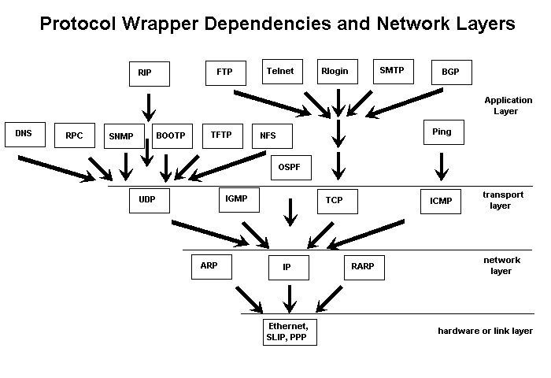
Protocols – A Visual
I will try to get this list of acronyms as references in the tutorial

Slide 38
More on Protocols
There are usually seven layers to many network communications – in terms of protocols:
Physical layer
Data link layer
Network layer
Transport layer
Session layer
Presentation layer
Application layer

Slide 39
More on Protocols (2)
To start with, at the physical layer, at the lowest level, bits are encoded in electrical, signals, light or radio signals.
At the data link layer errors might be detected. The transmission system has to be configured at this point.
The network layer deals with addressing for the transmission.

Slide 40
More on Protocols (3)
The transport layer deals with error detection and retransmission in the case of a faulty transmission.
The session layer responds to service requests from the presentation layer and issues service requests to the transport layer.
The presentation layer responds to service requests from the application layer and issues service requests to the session layer.

Slide 41
More on Protocols (4)
The application layer interfaces directly a user’s network applications.
It performs application services for the application processes such as handling requests for data from a remote node.
So this is the level where the user runs network functions – an example might be to ‘click on a link’ on the Internet.

Slide 42
More on Protocols (5)
Internet protocol
On the Internet, there are the TCP/IP protocols, consisting of:
Transmission Control Protocol (TCP), which uses a set of rules to exchange messages with other Internet points where 'information packets' are being sent.
/continued…

Slide 43
More on Protocols (6)
Using TCP, applications on networked host machines can create connections to one another to exchange data or packets.
This protocol is known as being reliable in delivering sender-to-receiver data.
TCP also distinguishes data for multiple applications happening at the same time.
/continued…

Slide 44
More on Protocols (7)
Internet Protocol (IP), which uses a set of rules to send and receive messages at the Internet address level.
IP is a data-oriented protocol used for communicating data across a packet-switched internetwork... (That will be the Internet, then? Aye.)
/continued…

Slide 45
More on Protocols (8)
Additional protocols that are usually included with TCP/IP are the Hypertext Transfer Protocol (HTTP) and File Transfer Protocol (FTP), each with defined sets of rules to use with corresponding programs that appear on the Internet in different places but need to be run to allow files to be sent/received.

Slide 46
Hardware for Networks – Network Transmission Media
Network transmission media generally fall into one of the following groups:
Copper wire - carries electrical signals, much like telephone or cable TV wiring.
Optical fibre - carries light-waves, either from lasers or Light Emitting Diodes.
Wireless - radio signals or infra-red light pulses
Each medium has its own advantages and disadvantages.

Slide 47
Copper Cable
Copper wire for network data transmission comes in two forms:
twisted-pair cable,
Similar to telephone cables, that contain 2 or more parallel wires that are twisted around each other, and
coaxial cable,
Similar to the cables used for cable TV. Each type of cable uses a different type of connector to interconnect computers or other hardware on the network.

Slide 48

Unshielded Twisted Pair Cable
Twisted pair cable comes in two varieties: shielded and unshielded. Unshielded twisted pair (UTP) is the most popular and is generally the best option for LAN networks.
Fig. 1. Unshielded twisted pair
The quality of UTP may vary from telephone-grade wire to extremely high-speed cable.

Slide 49
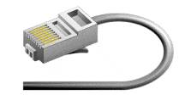
Unshielded Twisted Pair Connector
RJ-45 is the standard for unshielded twisted pair cabling connector. This is a plastic connector that looks like a large telephone-style connector. A slot allows the RJ-45 to be inserted only one way. RJ stands for Registered Jack, a kind of standard. This standard designates which wire goes with each pin inside the connector.
Fig. 2. RJ-45 connector

Slide 50
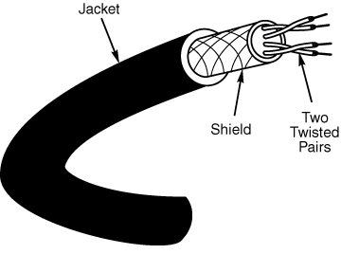
Shielded Twisted Pair Cable
A disadvantage of UTP is that it may be susceptible to radio and electrical frequency interference. Shielding reduces or removes these effects.
The shield acts as an ‘earthing’ or ‘ground’ in circuitry terms.
Fig. 3. Shielded twisted pair

Slide 51

Coaxial Cable
Coaxial cabling has a single copper conductor at its centre, a plastic layer provides insulation between the centre conductor and a braided metal shield. The metal shield helps to block any outside interference from fluorescent lights, motors and other computers.
Fig. 4. Coaxial cable

Slide 52


Coaxial Cable Connector
Bayone-Neill-Concelman (BNC) connector is sometimes used for coaxial cables. Connectors on the cable are the weakest points in any network. To help avoid problems with your network, the BNC connectors that crimp, rather than screw onto the cable are better.
Fig. 5. BNC connector

Slide 53
Fibre Optic Cable
Fibre optic cables are not affected by electrical interference and can carry data both at far higher transfer rates and for much greater distances than any copper cables.
In the past, the higher cost of optical fibre restricted its use to high-interference locations and network backbones (trunk lines) but its cost has dropped significantly in recent years and it is being used for all but the shortest distances (where twisted-pair is more convenient).

Slide 54
Fibre Optic Cable (2)
The major disadvantages of using optical fibre:
It can be more difficult to install in older buildings because it cannot be bent around corners as sharply as copper wire.
It is more difficult to attach connectors to optical fibre than to copper cable.

Slide 55

Fibre Optic Cable (3)
Fibre optic cable is used when high speed networking is required. Example: live video feed through networked computers with high-specification graphics processing.
Fig. 6. Fibre optic cable

Slide 56
Fibre Optic Cable (4)
Fibre optic cable consists of a centre glass core surrounded by several layers of protective materials, which enables it to transmit light signals at great speeds over much longer distances eliminating the problem of electrical interference.
Another example: optic cabling is ideal for environments that contain a large amount of electrical interference.

Slide 57
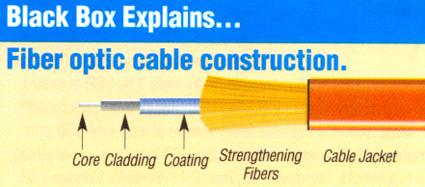
Fibre Optic Cable (5)
Here is a better diagram of a fibre optic cable…

Slide 58
Wireless Media
The range of transmission media for wireless networks is vast and still growing.
Originally, standard two-way radios were used, but they were very limited in reliability and transmission speed.
Point-to-point microwave radios, like those used by TV stations and telephone companies provide higher transfer rates (several Mbps) and are more reliable, but require tall towers and expensive hardware.

Slide 59
Wireless Media (2)
For longer distances, satellite relays can deliver Kbps, but are very expensive to build and operate.
Within a building, infra-red light pulses, like a TV remote control uses, work well for short distances, but at low transmission rates.

Slide 60
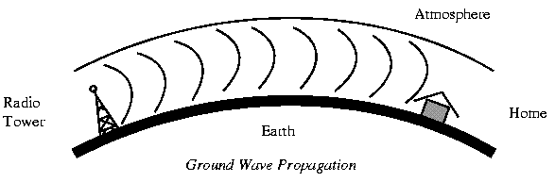
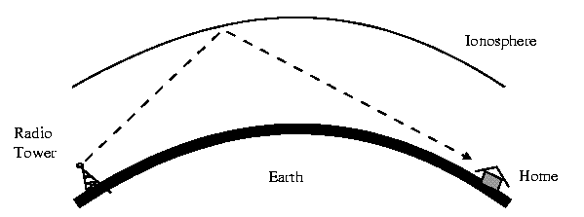
Point to Point Transmission of Microwave Radio Signals

Slide 61
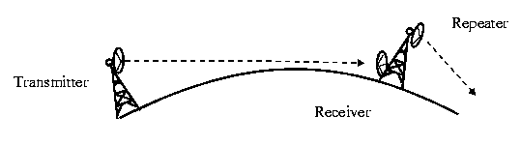
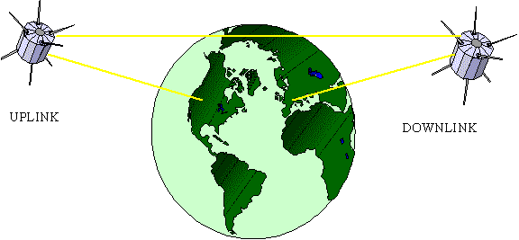
Point to Point Transmission of Microwave Radio Signals (2)

Slide 62
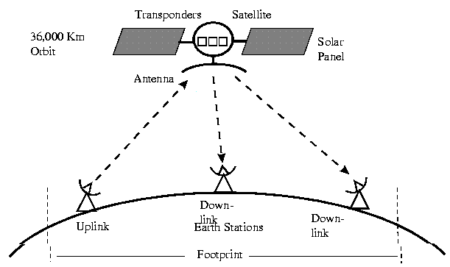
Point to Point Transmission of Microwave Radio Signals (3)

Slide 63
Internetworking
An internetwork is a collection of individual networks, connected by intermediate networking devices, that functions as a single large network. Internetworking refers to the industry, products, and procedures that meet the challenge of creating and administering internetworks. The diagram below illustrates some different kinds of network technologies that can be interconnected by routers and other networking devices to create an internetwork.

Slide 64
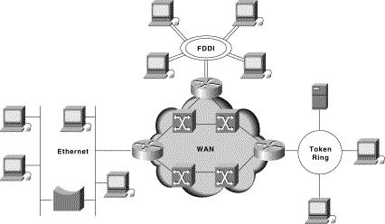
Internetworking (2)
Different network technologies can be connected to create an Internetwork

Slide 65
On an Internetwork
The more visible aspects to a user of ‘internet’ is the browser.
A browser is a graphical user interface-based hypertext client application, such as Explorer, Mosaic, and Netscape Navigator, used to access hypertext documents and other services located on remote servers throughout the WWW and Internet.
The visible language is ‘Hypertext’.

Slide 66
End of Networks
That describes the background to information technology networks. The description started with a broad view of networks in terms of functionality and size, before covering such examples as Client-Server networks, protocols and connection types.
Are there…
ANY QUESTIONS?

Slide 67
Where to Next?
NEXT:
The two themes of the next lecture:
“Interface Types” and
“Software Types and Applications”
How are instructions, data and signals moved across computer systems?
What is important to note about software? What makes a software application? We can look at these things next.

Slide 68
Thanks for your attentiveness.
See you here next time. Be safe and well in the meantime.

